Slide 1
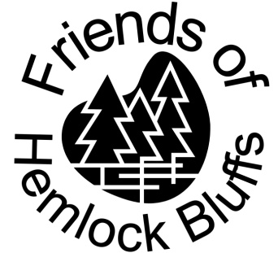


Hemlock Bluffs Nature Preserve
Activity Booklet
Junior Explorer
(ages 5-8)
Originally created by
Mary Burroughs (2007)
Updated by
Deanna Stewart (2009)
Kelly Dempsey (2014)
Sadie Lang (2021)

Slide 2
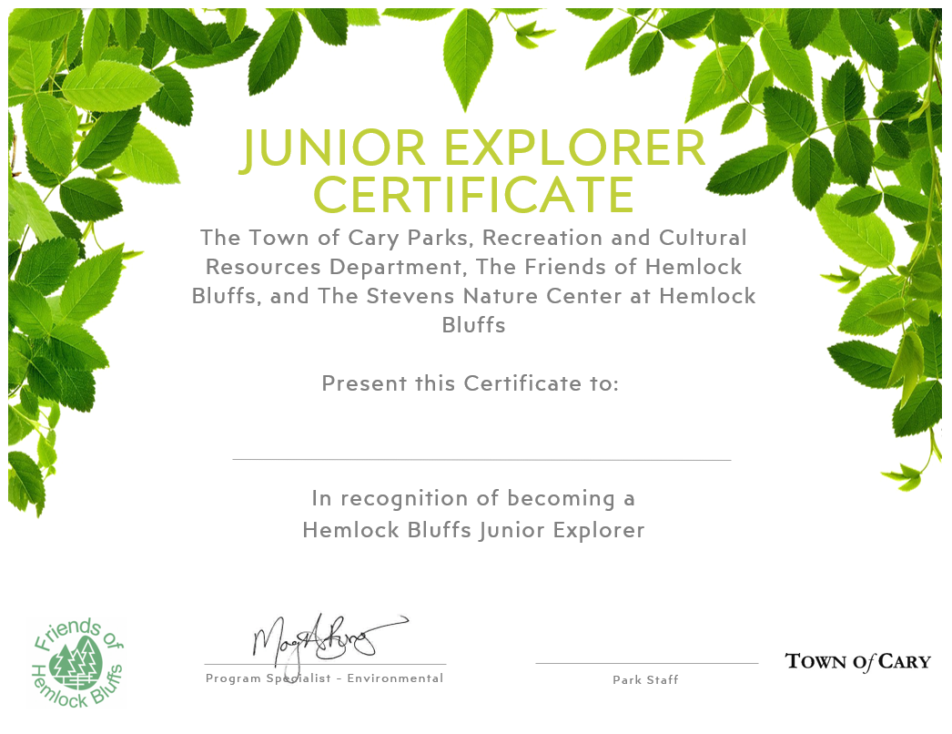
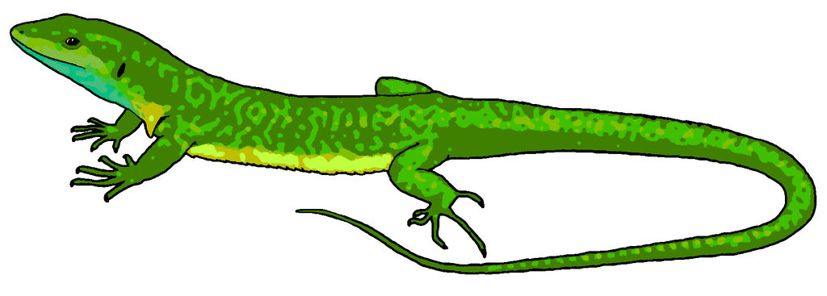
2
19
This book belongs to:
_______________________________
I am ______ years old.
I live in ___________ County, in the State of _________________________, and go to school at: _____________________________________.
My address is:
__________________________________________________________________________
My hobbies are: __________________________________________________________________________
I like nature because: ____________________________________________________________________________________
CONGRATULATIONS on completing the Hemlock Bluffs Junior Explorer Program! We hope that you have learned a lot and that you had fun completing the activities in this booklet. You are now a Junior Explorer! Take your completed booklet to the front desk in the Stevens Nature Center to receive your prize. Be sure to write your name in the Junior Explorer log and tell your friends about the program!

Slide 3

18
3
reflection
Welcome to the Hemlock Bluffs Nature Preserve Junior Explorer Program! Use these fun activities to learn about nature here at the preserve and see what you can discover about nature near your home, school, or other places. We hope that by learning about nature, you will want to help conserve it for others to enjoy.
Use this space to write a story or draw a picture based on everything you saw and learned at the nature preserve today.
HOW TO BECOME A
JUNIOR EXPLORER
Complete 8 activities in this Junior Explorer booklet, including one from each category:
2. Hike Swift Creek Loop Trail.
Check this box after your hike.
Around the nature center
Wildlife
Plants
On the trails
Reflection

Slide 4
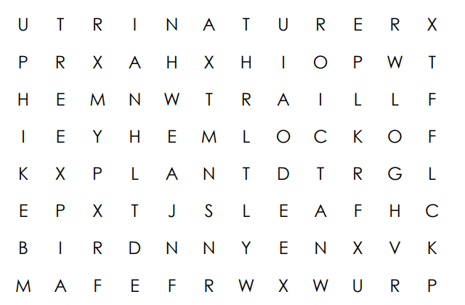
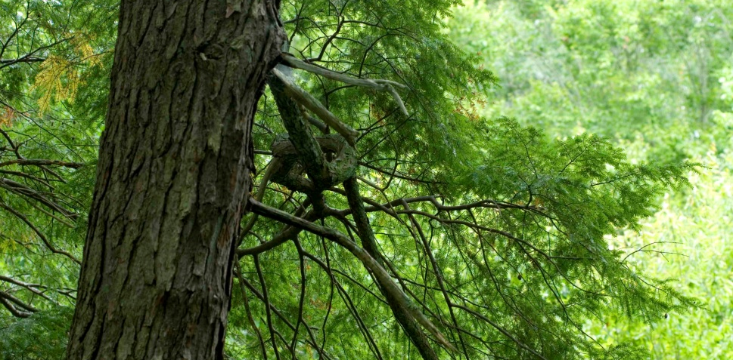
4
17
WHY IS HEMLOCK BLUFFS SPECIAL?
Hemlock Bluffs is home to Eastern Hemlock trees. These trees are normally only found in the mountains of western North Carolina – 200 miles away! The hemlocks in the nature preserve live along the bluffs (small cliffs) which face north, providing cooler, mountain-like temperatures. Flowing along the bluffs, Swift Creek creates a moist environment that helps support the hemlocks.
Word hunt
Can you find these words?
NATURE LEAF TRAIL
PLANT TREE HIKE
HEMLOCK BIRD LOG
Why do YOU find Hemlock Bluffs special?
____________________________________________________________________________________________________________________________________

Slide 5
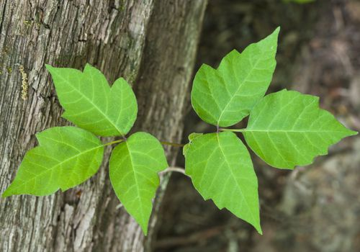
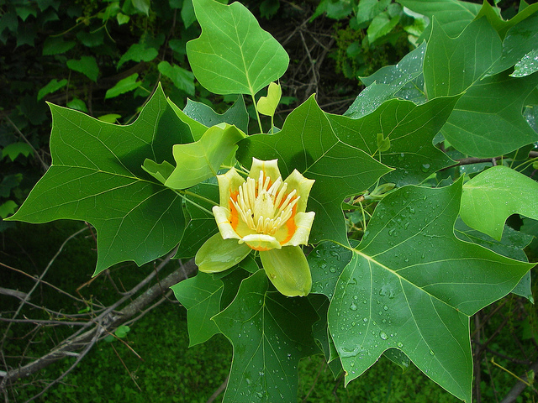
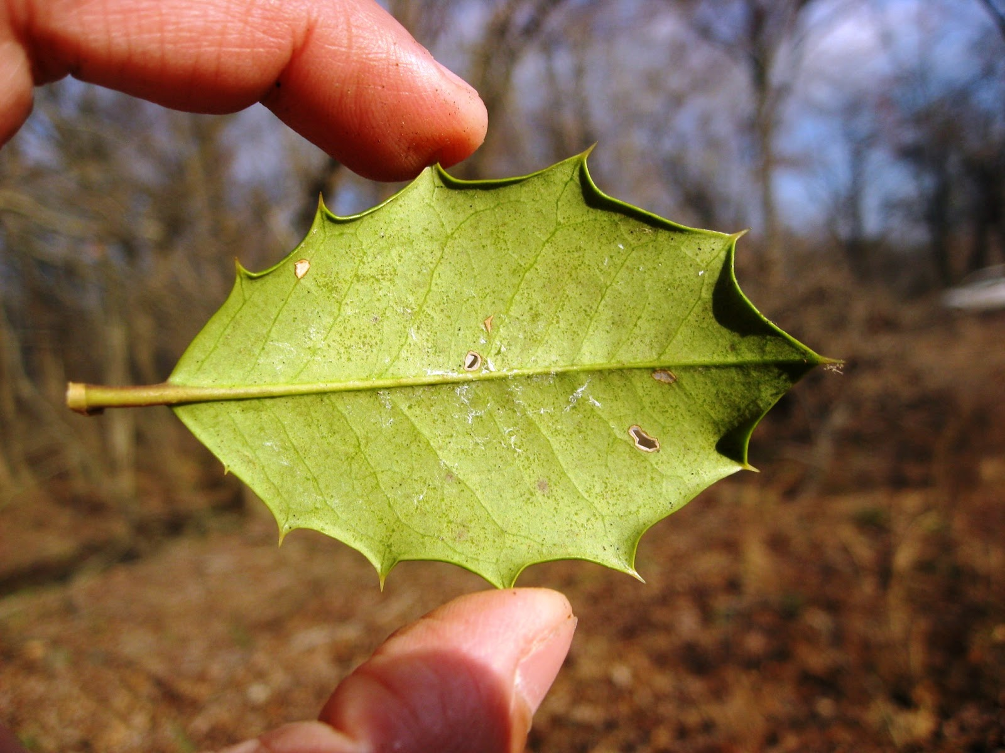
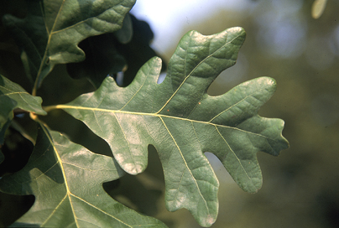
16
5
GET READY FOR YOUR HIKE . . .
To keep our nature preserve looking good for our visitors and to make sure all the plants and animals have a nice place to live, we have some rules:
1. Stay on the Trail
2. Don’t Litter
3. Leave Nature in the Preserve
(No Collecting!)
Leaf Scavenger hunt
Leaves come in all different shapes and sizes! See how many different types you can find:
I see a leaf that is…
_____ round
_____ long and skinny
_____ heart shaped
_____ triangle shaped
_____ star shaped
_____ needle-like
_____ bigger than my hand
_____ smaller than my hand
_____ has rounded edges
_____ has points on its edges
_____ has a hole in it
_____ on a plant taller than me
_____ on a plant shorter than me
_____ from a vine
_____ from a fern
_____ thin and papery
_____ different than other leaves on the same plant
Watch out for poison ivy!
THE JUNIOR EXPLORER PLEDGE:
As a Junior Explorer, I promise to help protect and care for Hemlock Bluffs Nature Preserve. I will continue exploring outside in nature, and I will tell my family and friends about the cool things I learned.
Signed: ________________
Tulip poplar
American holly
White oak

Slide 6
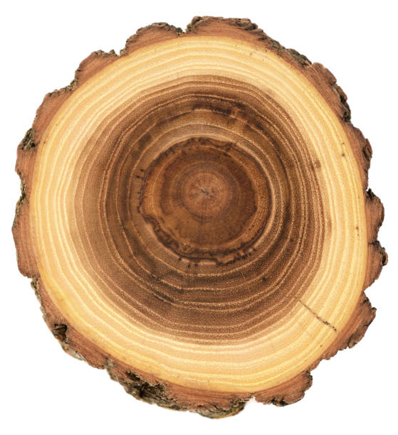
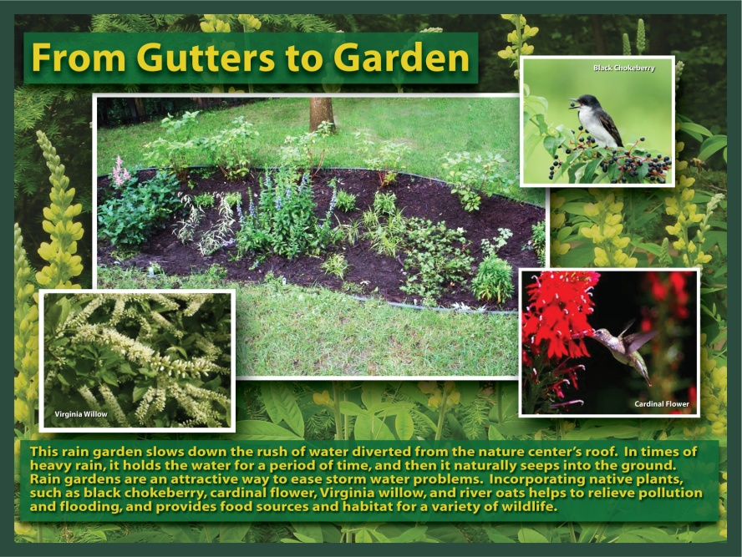
6
15
Rain, rain, don’t go away
A rain garden is a special type of garden. They are very helpful in urban areas with lots of impervious surfaces - ground that is too hard for water to soak into, like roads, driveways, and tightly packed yards.
Visit our rain garden and see why they are important! Write down three reasons that you can think of – use the signs to help you learn more.
1.______________________________________________________
2.______________________________________________________
3. _____________________________________________________
Terrific trees
A tree adds a layer of new wood every year. These layers are called tree rings. By counting them, you can estimate the age of a tree.
Find a tree “cookie” (a cross section of a tree trunk) from a tree that was cut down in your yard. Or, check out the one on display in the Stevens Nature Center. Count the rings. About how old was this tree?
_______________________________
Not all layers are created equally! You might notice some of the rings are wider than others. Narrow rings may be created in years when growing conditions were tough, such as drought or crowding. Draw a sketch of your tree rings here:

Slide 7
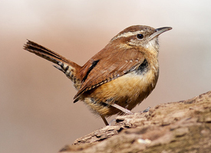
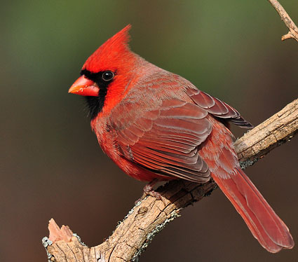
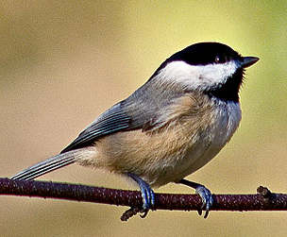
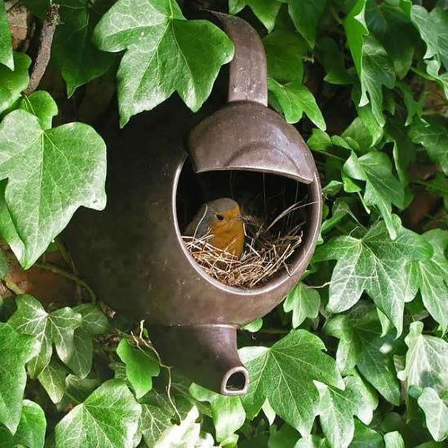
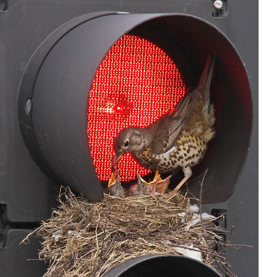
14
7
Bird behavior
Gardens Galore
Go outside and observe birds around the preserve or in your backyard! Observe birds doing at least 5 of the things listed below and check them off.
If you provide the right tools, gardens can help wildlife, too. They can provide food, water, and shelter, just like a natural habitat.
Did you know that the Carolina Chickadee will re-use an old woodpecker nest for their own? Like them, people are great at re-using things for reasons besides their original design.
Can you find three things in the recycle garden that are used to help provide for wildlife?
1._________________________________________________
2. _________________________________________________
3. _________________________________________________
Have you ever seen an animal re-use something in your house or yard, even if it wasn’t meant for wildlife? Tell us about it here: _________________________________________________________________________________________________________________________________________________________________________________
___Walking or hopping on the ground
____Preening (grooming feathers)
____Flying with food or nesting material
____Flying (flapping wings)
____Soaring (no flapping)
____Singing or calling
____Bathing in water
____Sitting on a nest
____Climbing a tree
____Feeding
Find one of the birds in the pictures above on the trail and circle it!
When bird watching… 1. Keep the sun at your back 2. Stay still and quiet 3. Be patient | To Identify Birds, Look At… 1. Size 2. Color 3. Shape 4. Markings 5. Behavior

Slide 8

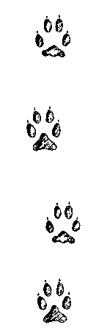
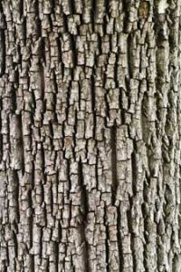
8
13
Take a walk around the nature center exhibit hall
Creepy crawlies
Tricky Tracks
Many of our mammals here are nocturnal (they come out at night) and so are hard to see. We usually only see signs they’ve been nearby recently, such as with their footprints (tracks). Using the track table, identify the following prints:
Did you know that insects, worms, and millipedes are all animals too? See if you can find any of these creatures around the garden areas or in your own back yard.
A good way to find creepy crawlies is to gently lift a log or rock and look beneath. Carefully place it back when you are done.
See if you can find each of these and draw a picture. Make sure to put creatures back where you found them when you are done with your observations.
___________
___________
___________
___________
1 2 3 4
An animal with 6 legs
An animal with 8 legs
Find the four pieces of tree bark mounted on the wall and feel each one.
Which tree feels the smoothest?
______________________________________
Which tree feels the roughest?
______________________________________
An animal with no legs
An animal with many legs

Slide 9





12
9
Habitat hunt
Sound and color
All animals – including you! – have basic needs to live. We all require shelter, water, and food. On this page you can find examples of ways people meet these needs – can you find ways animals meet these needs at the preserve? Draw or describe an example of what you see.
Sit or lie down on a bench on the trail. Close your eyes and put up a finger every time you hear a natural sound. Listen until you hear at least 5 sounds and then write down what you heard.
1.____________________________________
2.____________________________________
3.____________________________________
4.____________________________________
5.____________________________________
Food
Shelter
Open your eyes but don’t move.
How many different colors do you see? ______________________________________
What color do you see most?
______________________________________
Water

Slide 10
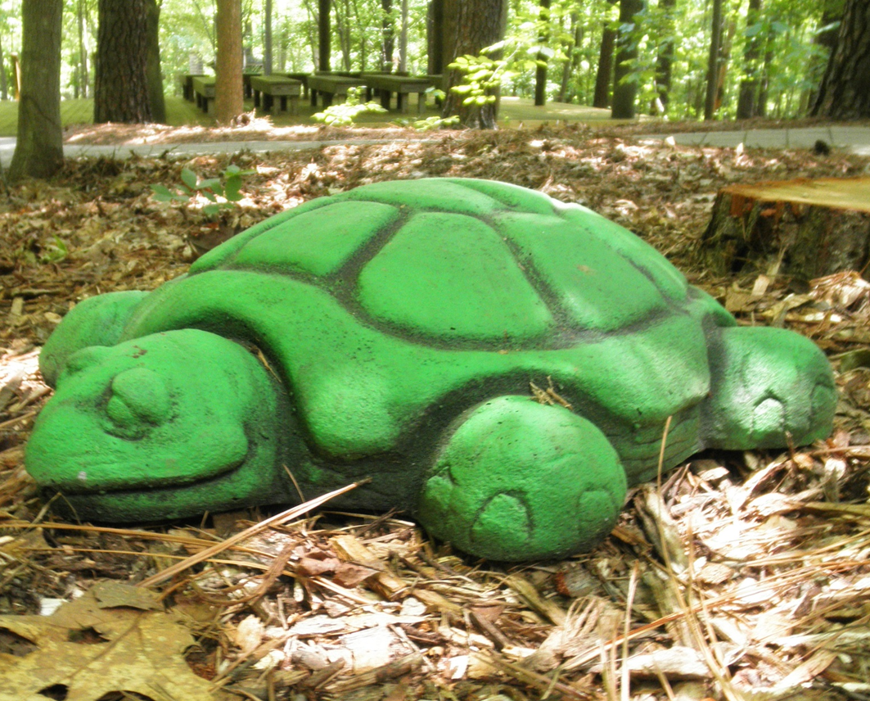
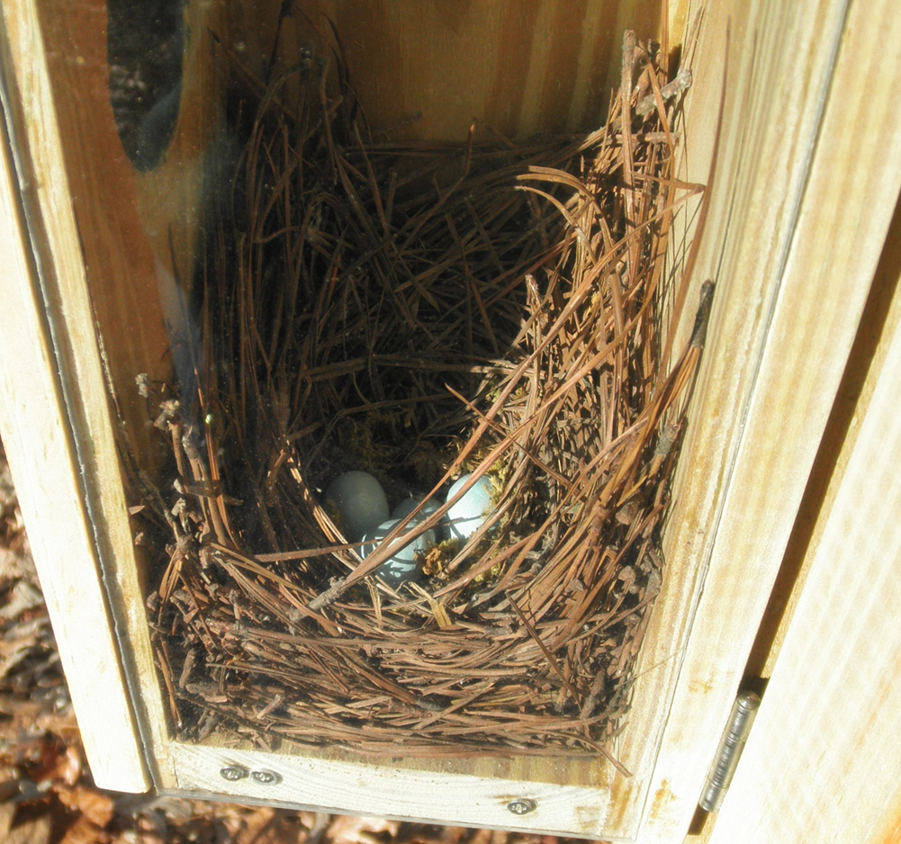
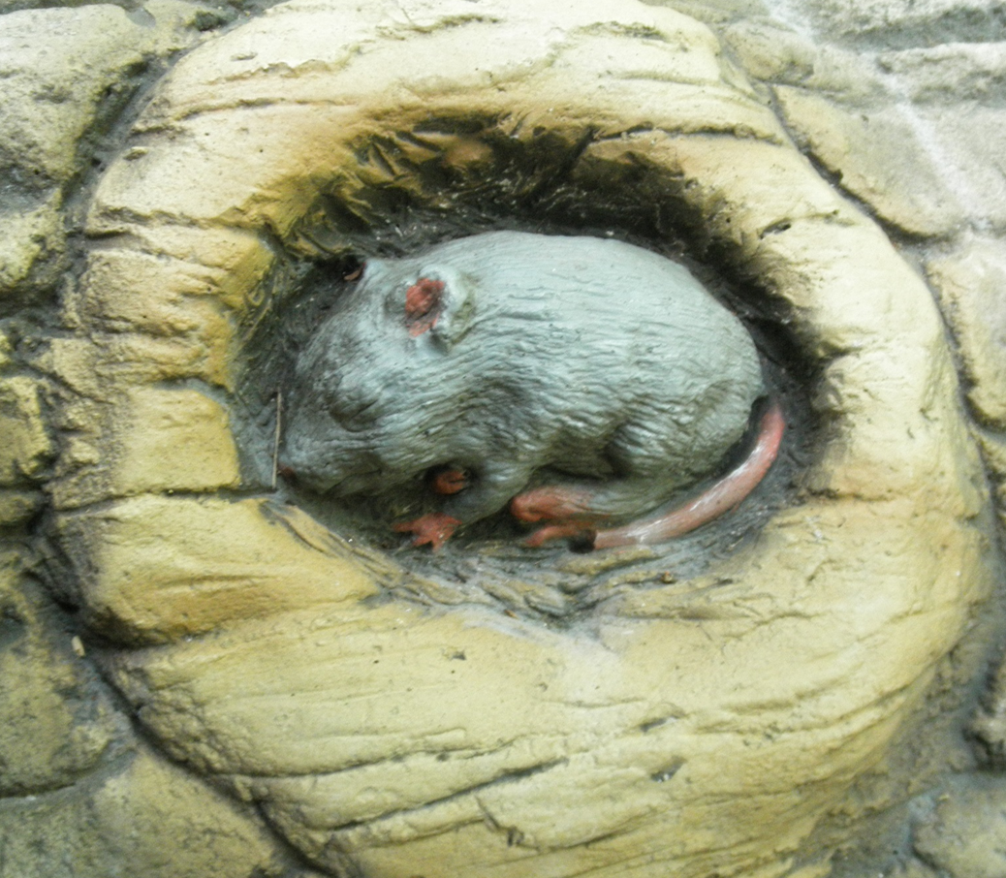



10
11
Explorer bingo
Explore the children's nature trail
As you hike along the trails, draw a picture or mark off the things listed below as you see them. Try to get 5 in a row! Remember to leave what you find where you found it.
Can you find these objects hidden around the Children’s Nature Trail? Check them off when you do!
Pinecone | Trail Sign | Tree with a hole in it | Bird | Creek
Spider | Insect | Birdhouse | Trash Can | Stump
Nest | Squirrel | Free (Make your own!) | Snag (standing dead tree) | Leaf
Rock | Acorn | Lizard | Fern | Deer
Bench | Flower | Eastern Hemlock | Frog | Bridge
Move your body!
Find the green turtles
Hop from turtle to turtle like a frog
Find the wooden balance beam
Walk along it, balancing like a squirrel
Find the tree log tunnel
Slither through the log like a snake
The trails of Hemlock Bluffs are full of interesting things. Some are natural, and some are man-made, but they are all important for both animal residents and preserve visitors. Did you know that logs are very important habitats for animals like salamanders and insects? Don’t forget to put any trash you might have in the trashcans along the trail!

